Slide 1
Celery on AWS ECS - art of background tasks & continuous deployment
Jan Giacomelli
March 2023

Slide 2

About me
Staff software engineer at ren.co
Author of tutorials & courses at testdriven.io
Twitter: @jangiacomelli

Slide 3
Async background tasks
Long running tasks
Example: Delete all user data
Repeated (scheduled) tasks
Example: Send newsletter every Monday
Tasks that needs retries
Example: Send welcome email

Slide 4
Celery
Most widely used task queue in Python community
Message broker (e.g., Redis, RabbitMQ, …)
Workers
Celery beat for scheduled tasks

Slide 5
AWS ECS Fargate
No provisioning of servers - Docker image only
Easy to increase resources (CPU/Memory) per worker
Easy to scale up/down
Easy to set up autoscaling
Easy to deploy

Slide 6
AWS ECS Fargate - configuration
ECS Task: stopTimeout=120
120 seconds between SIGTERM and SIGKILL
Gives containers as much time as possible to gracefully exit
ECS Service: Use minimumHealthyPercent=50
To have at least 50% of desired workers running at all times

Slide 7
AWS ECS Fargate - interruptions
Deployment
Current containers are killed
New containers are started
Scaling
Up: New containers are started
Down: Current containers are killed
First SIGTERM is sent, SIGKILL is used afterwards if container is still running

Slide 8
AWS ECS Fargate - continuous deployment
Frequent deployments, multiple times per day
Every deployment is an interruption
Long tasks (e.g., 5h) may not be finished during office hours
Interrupted by deployments
Tasks might be lost due to workers being ungracefully killed

Slide 9
Celery on AWS ECS - late task acknowledgement
Default: False - tasks are acknowledged when received
A task may never be successfully processed if a worker is killed
Use late acknowledgement - after a task is processed
Use: celery_app.conf.task_acks_late = True

Slide 10
Celery on AWS ECS - visibility timeout
Default: 1h
Time before another worker picks up task
Longest timeout must not be longer than visibility timeout
Keep it short to quickly retry a task in case of killed worker
celery_app.conf.broker_transport_options = {"visibility_timeout": datetime.timedelta(minutes=15)}

Slide 11
Celery on AWS ECS - countdown
Be careful when you use it - ideally, don’t use it
Tasks with countdown are fetched from a broker and stored inside the worker’s memory until the countdown passes
If the countdown is greater than the visibility timeout, the task will be processed multiple times
Worst case, every worker will process the task

Slide 12
Celery on AWS ECS - reject task on worker lose
Default: False - tasks are not rejected when worker is lost
Tasks will be acknowledged when worker abruptly exists or is killed by signal
Even with late acknowledgement
Without it, task may never be fully processed
Most of the time, we want that tasks are processed at least once
celery_app.conf.task_reject_on_worker_lost = True

Slide 13
Celery on AWS ECS - prefetch multiplier
Default: 4
One is being processed, three others are prefetched and waiting in the worker’s memory
Using more than one might result in multiple tasks being retried only after visibility timeout - in case of a killed worker
celery_app.conf.worker_prefetch_multiplier = 1

Slide 14
Celery on AWS ECS - signal re-mapping
Default: SIGTERM -> Warm shutdown
Use cold shutdown for workers
Tasks are handled as in lost worker scenario - retried after visibility timeout
Ensures that no task is lost
export REMAP_SIGTERM=SIGQUIT

Slide 15
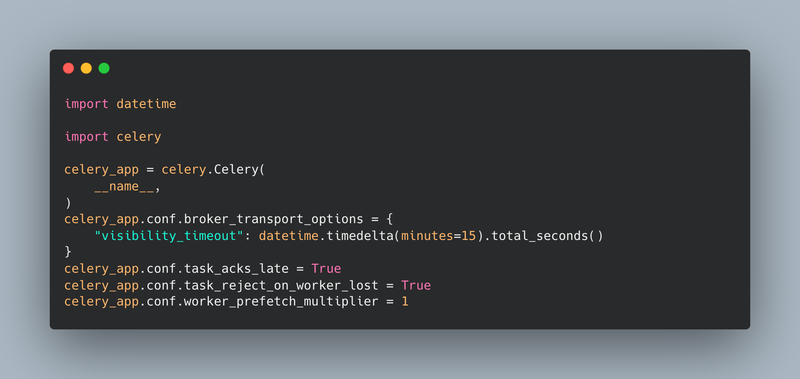
Celery on AWS ECS - example configuration

Slide 16
Tasks
Short
Max processing time < 15 minutes
Typical processing time < 2 minutes
Idempotent
Running it multiple times must not break things
Every run must produce the same result
Retries
Use retries with exponential backoff with jitter - external API’s might be down, etc.

Slide 17
Tasks
Maximal task processing time must be shorter than typical window between deployments.

Slide 18
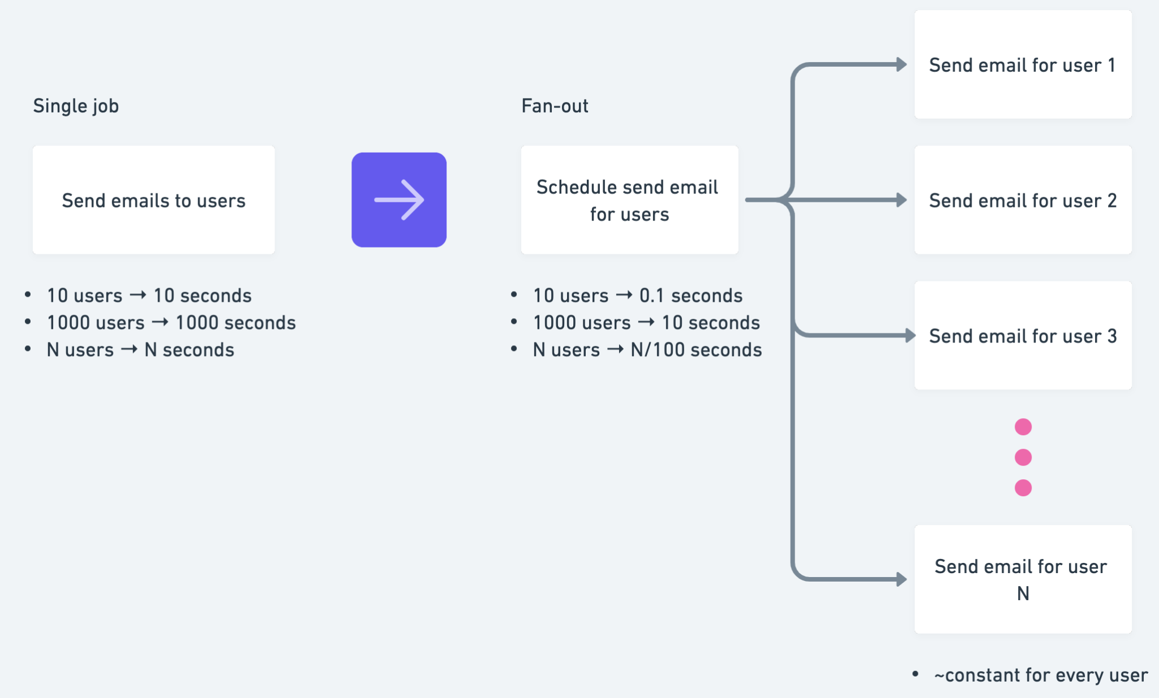
Tasks - fan-out

Slide 19
Tasks - fan-out
Fan-out job (e.g., scheduler) processing time increases much slower than of single job
You can use multiple fan-out layers (e.g., for every user -> for every post -> for every comment)
Submits a lot of tasks at once - workers are jammed
High-priority tasks - the ones that need to finish ASAP
Everything else will need to wait

Slide 20
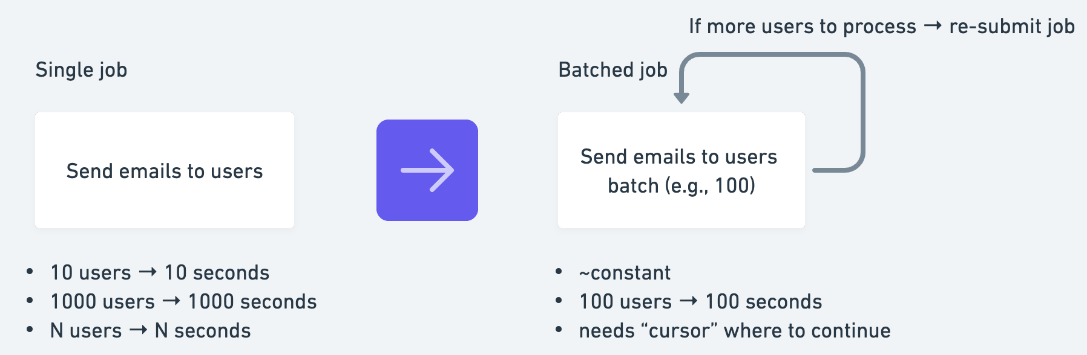
Tasks - batching

Slide 21
Tasks - batching
Occupies one worker at the time
Takes more time to finish the whole process
Execution time per-job run is ~constant
If interrupted, it continues from beginning of the interrupted batch - not from beginning of the whole process
Harder to implement compared to fan-out

Slide 22
Tasks - locking
Two workers might pick up the same task
We don’t want parallel processing
Use locking with Redis
Auto-expire lock - slightly smaller value than for visibility timeout

Slide 23
Tasks - locking
Ignore task
Ensures “at most once” processing - when worker that picked up the task first is killed, the task is not processed - it’s considered as successful from the worker that picked it up second
Re-submit task with same arguments
Ensures “at least once” processing - even when the worker that picked up the task first is killed
Retry task
Conceptually more correct, but you might run out of retries when multiple interruptions in a row

Slide 24
Working example
Celery ECS example

Slide 25
Resources
AWS ECS Task configuration reference
AWS ECS Service configuration guide
Celery configuration guide
Heroku Celery guide
Celery Task Cookbook

